Slide 1






Trusted by leading engineering providers:

Slide 2
Industry Challenges
Manual Entry
Human Error
Inconsistent Formats
Inspectors waste >50 hours a month doing manual data entry
Managers spend hours checking for reporting errors every week
Clients see inconsistency in the quality and format of reports across different inspectors
Notes:
They submit it for review and there are a bunch of errors - they might write that they used a specific procedure, but it turns out that procedure conforms to an ISO standard rather than an ASME one. All of a sudden, the report is invalidated, and you have to do a bunch of rework.

Slide 3
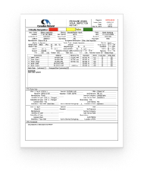
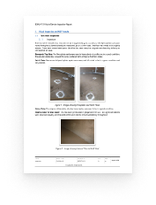


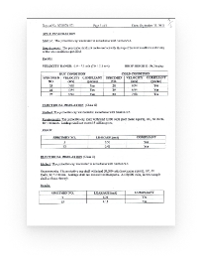

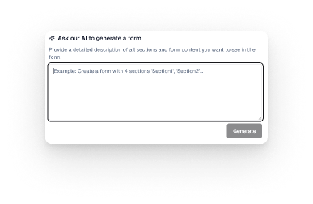


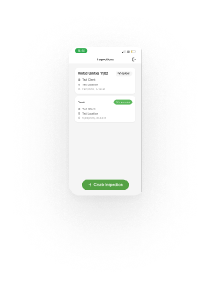
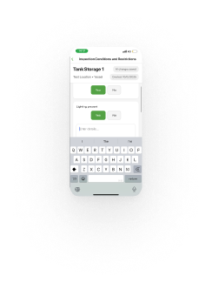




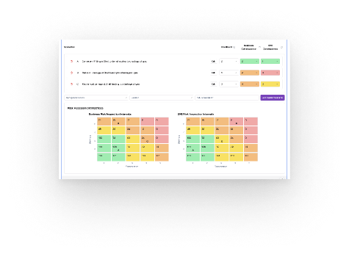


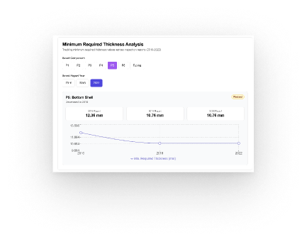


How it works
Digital Delivery of Reports
Create workflows with standards and AI
Automated data clean up
Collect and add data in field/labs with speech and video
Clean
Sync
Extract and input data from any source
Comply
Automatically Generated Dashboards
Regulatory
Requirements
P&ID Diagrams
Inspection
Reports
Notes:
How it works is that we take in your existing procedures, and ingest a bunch of contextual data including regulatory requirements, P&IDs, historical inspection reports etc. We clean this up and standardise the extracted information to pre-populate your next report, and then give you a super easy to use tool in the field where you can speak into it, take photos, and extract information from these so that your report is written by the time you're off site. sell outcomes - better compliance with standards, faster/accurate reporting with data automatically input, upsell on dashboards and reporting consistency Sell outcomes - Finally we export this - and you can often sell this to your end customers as an upsell - I know Mike mentioned Yorkshire Water is an example of someone who would potentially love this (as they're doing the re-entry of data collected on their side)

Slide 4
Proven Results
We are established as the leading solution for complex data ingestion and reporting
Cut reporting time by 80%
2x faster inspections with the same headcount
Major increase in efficiency
Notes:
And since starting we're fortunate to have worked with a bunch of customers in the TIC industry to make a huge difference to how they do their reporting. Where we shine is when our clients work with folk that are multisite, ideally have long term contracts - so ideal customers for us are folk like Rosen who already use us in Europe, yourselves, Oceaneering, Bilfinger etc.

Slide 5
Case Study - TÜV Rheinland

Slide 6
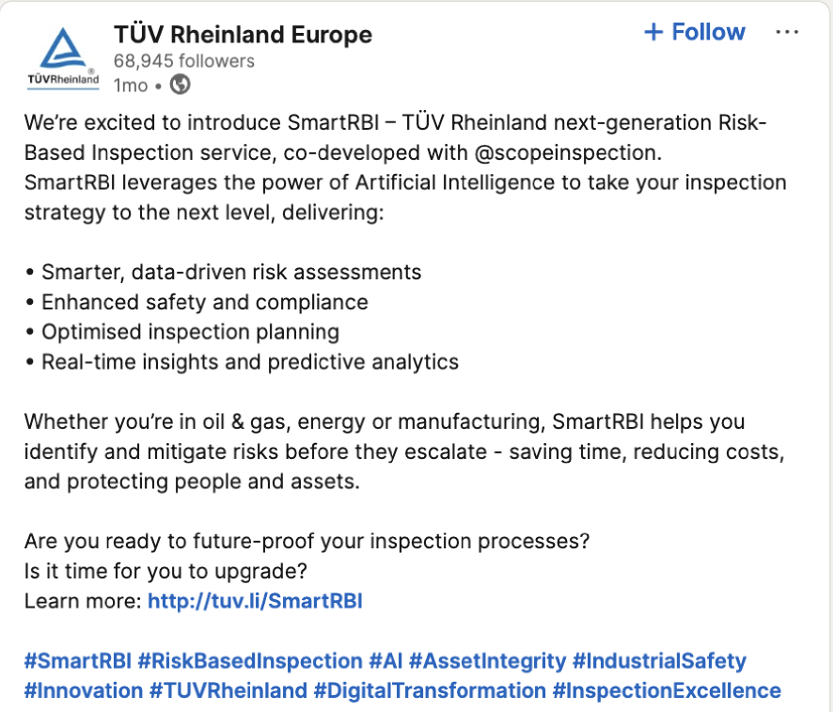

TÜV - SmartRBI cobranding
Notes:
TÜV are one of our flagship clients who we've done a bunch of cobranding/marketing with to help them win new contracts. This is an example of some of the materials which led to them winning a £1.2m contract with united utilities QBR with clients We've done Mistsubishi Chemicals, CF Fertilisers, Shell

Slide 7
Outcomes post 3 months deployment
Inspectors
Contract Won
Inspection time
Uptime
+50 hrs
£1.2M
5x
99.99%
saved per inspector per month, freeing inspectors for other projects and driving efficiency gains
deal secured for a major client through competitive pricing enabled by inspector efficiency
faster delivery of inspection results and risk assessments through automation
software uptime, without bugs or any other issues - 4 minutes a month
Notes:
And here are the broader outcomes we've driven for TÜV - essentially saving 50 hours per month for every inspection, speeding up the inspection time meaningfully. Also maybe helpful to note, we're also doing some work for TUV on the HSE side for point of work risk assessments - when they open the mobile app up before doing an inspection they're able to do an initial form for their HSE which doesn't go to the client

Slide 8

















Trusted by Global Leaders

